Slide 1



ABC Call Volume Trend Analysis
Alankar Saxena

Slide 2


ABC Call Volume Trend
Average Call Duration
Call Volume Analysis
Manpower Planning
Nightshift Manpower Planning

Slide 3
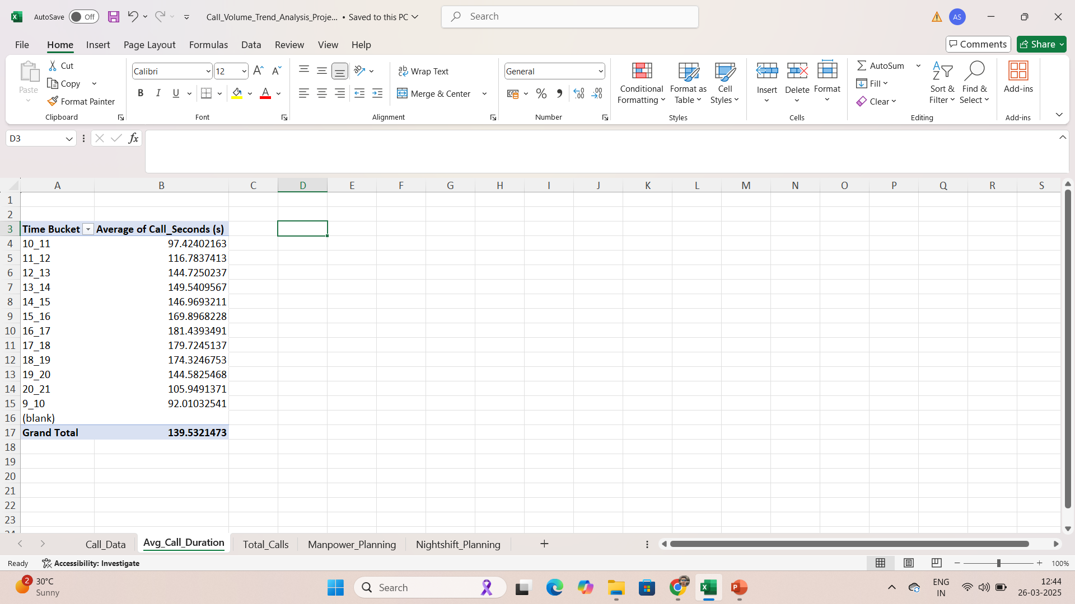
Average Call Duration
Average call duration in seconds in shown for each time bucket.
In morning 9AM to 10AM lowest call duration are detected.
Average call duration increases from morning to afternoon and evening with maximum average calls occurring between 4PM to 5PM.
After 5PM average call duration again decreases.
It shows that in afternoon and evening, either customers talk freely and explains or the agents are listening and talking more effectively in that time.

Slide 4
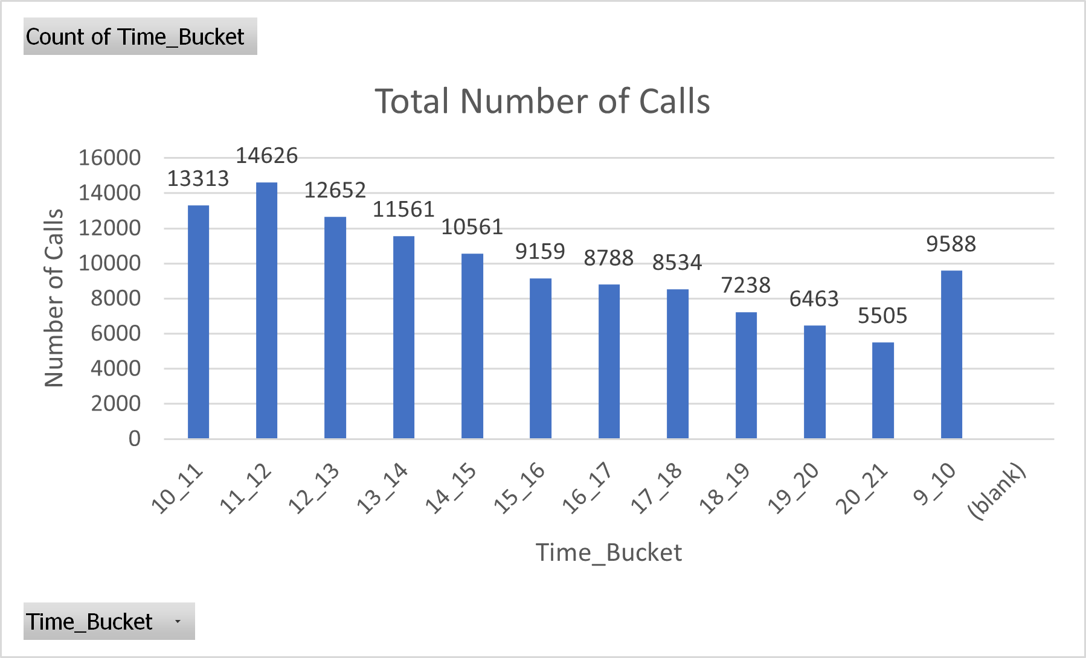
Call Volume Analysis
Total number of calls are shown in the graph for each time bucket.
In morning time, the total number of calls are high compared to in afternoon and evening.
11AM to 12PM records highest number of calls in a day, after 12 PM total count decreases continuously.

Slide 5
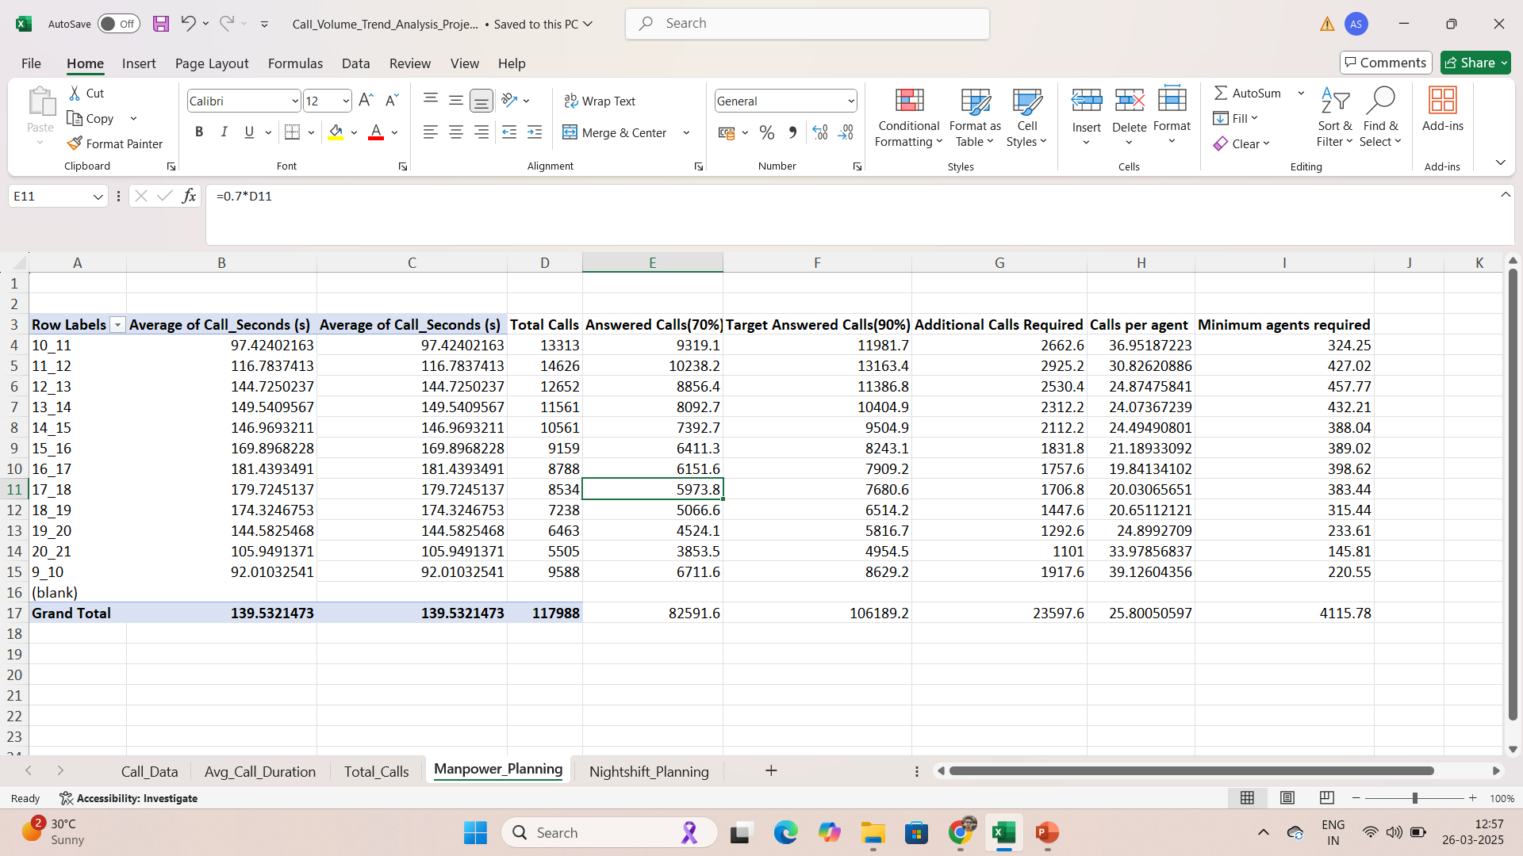
Manpower Planning
Manpower planning for better efficiency to reduce abandon rate of calls is calculated in the table.
Average duration of a call for each bucket is calculated with average duration of a call in whole day 140 seconds.
To reduce abandon rate to 10%, receiving rate will be 90% of total calls.
Calls taken by an agent in a day is calculated with average 25 calls in a day.
Minimum agents required for each time bucket is calculated to reduce abandon rate to 10%.

Slide 6
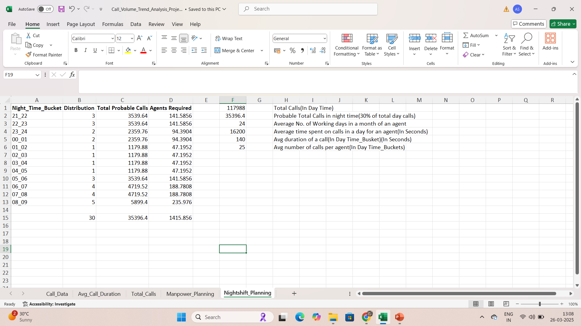
Nightshift Manpower Planning
Nightshift buckets are created from 9PM to 9AM which is 30% of the day time calls and respective distribution is shown out of 30%.
Total probable calls are calculated for each nigh time bucket.
Total agents required for each time bucket are calculated with total probable calls in that respective night time bucket and average calls per agent calculated for day time.

Slide 7
Link
https://docs.google.com/spreadsheets/d/1C1FGTKelQFyvxCmwkwyGlzK9jYxVQoAg/edit?usp=sharing&ouid=100987342170051497390&rtpof=true&sd=true

Slide 8
THANK YOU

